Slide 1
Introduction to Deep Reinforcement Learning
Yen-Chen Wu
2015/12/11
Notes:
10 slide + DQN + continuous + double + distil

Slide 2
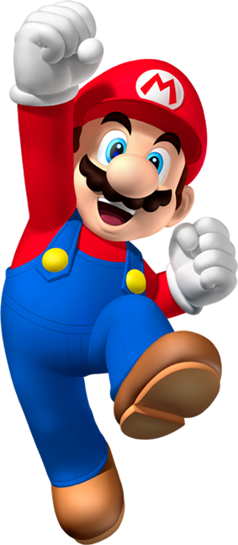
Outline
Reinforcement Learning
Markov Decision Process
How to Solve MDPs
DP
MC
TD
Q-learning (DQN)
Paper Review

Slide 3
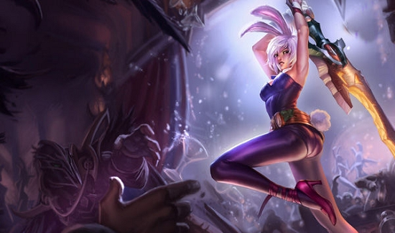
Reinforcement Learning

Slide 4
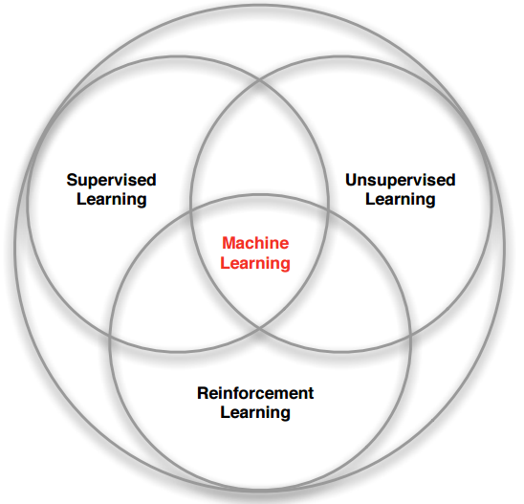
Branches of Machine Learning

Slide 5
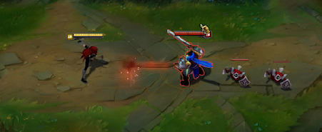
What makes different?
There is no supervisor, only a reward signal
Feedback is delayed, not instantaneous
Time really matters (sequential, non i.i.d data)
Agent’s actions affect the subsequent data it receives

Slide 6
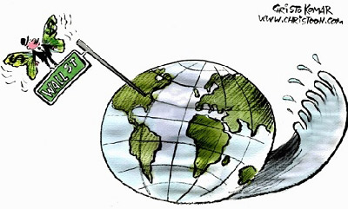
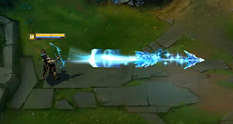
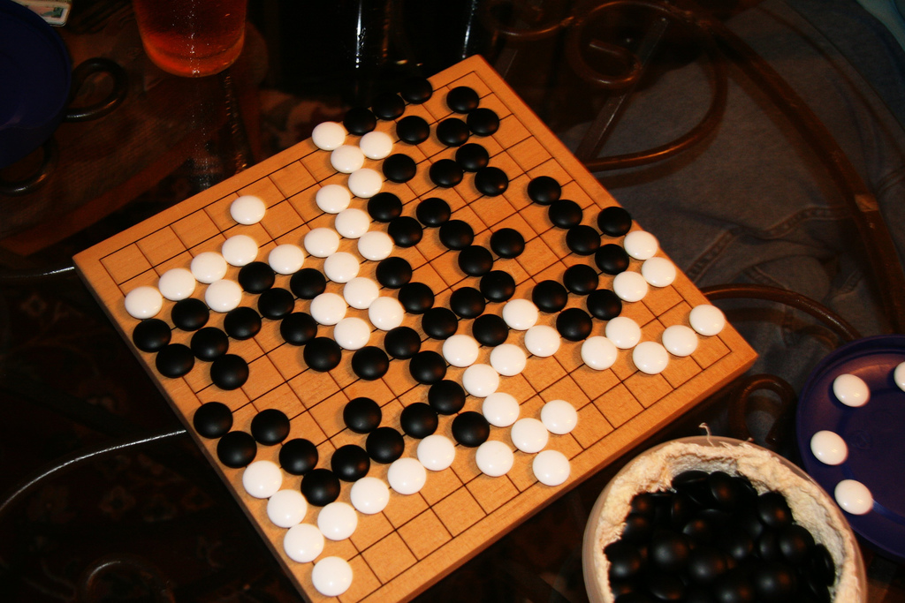
Goal: Maximize Cumulative Reward
Actions may have long term consequences
Reward may be delayed
It may be better to sacrifice immediate reward to gain more long-term reward

Slide 7
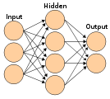
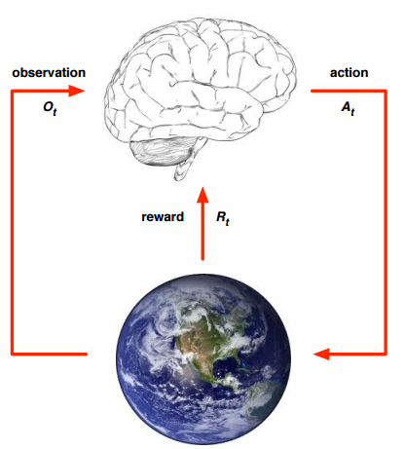
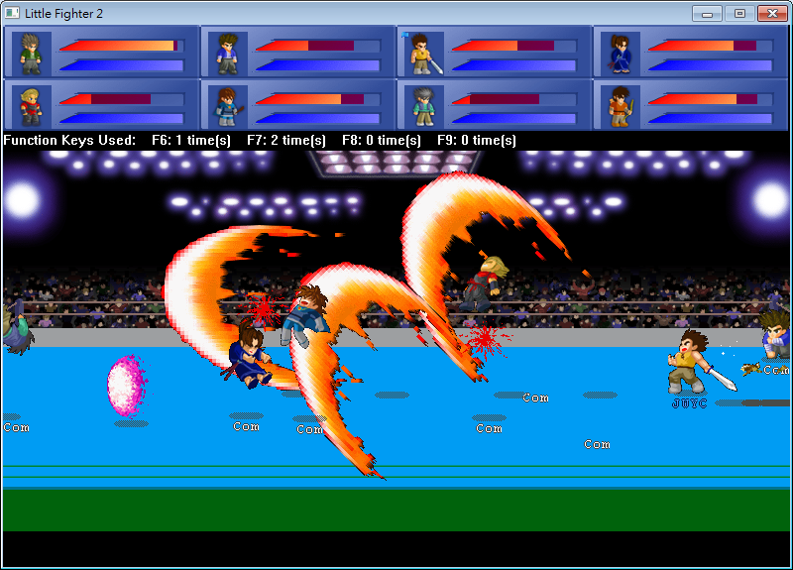
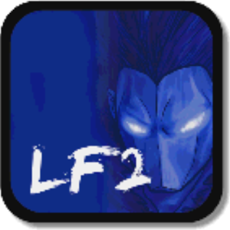
Agent & Enviroment
→←↑↓
Defense
Attack
Jump

Slide 8
Full observability vs Partial observability
Learning and Planning
Exploration and Exploitation
Prediction and Control

Slide 9
Markov Decision Process
Markov Processes
Markov Reward Processes
Markov Decision Processes

Slide 10
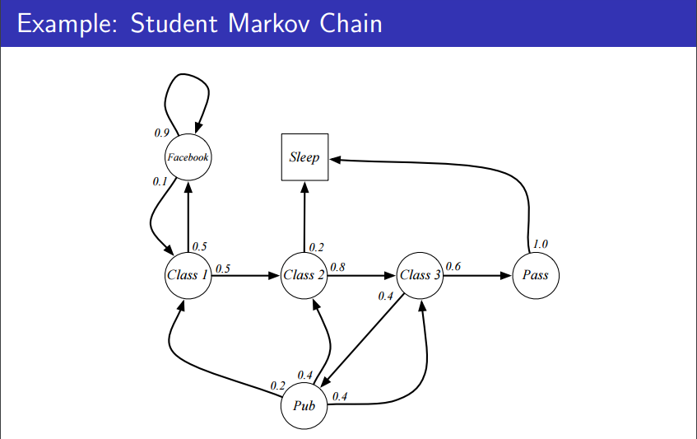
Markov Process

Slide 11
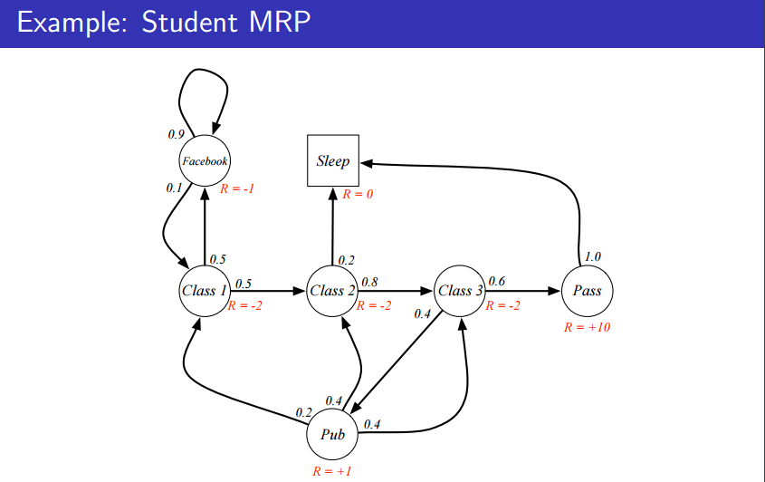
Markov Reward Processes

Slide 12
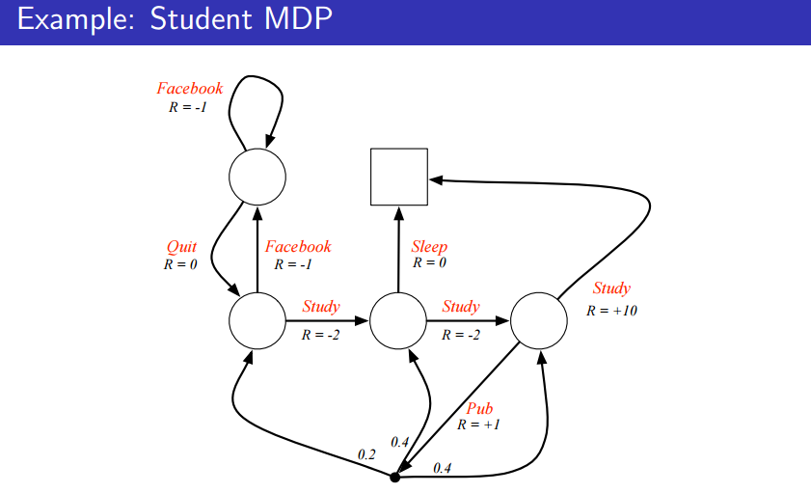
Markov Decision Process
Notes:
with decisions

Slide 13
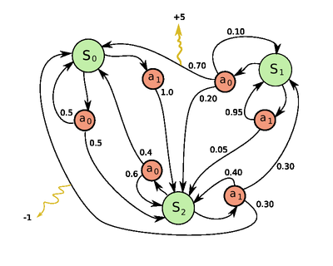
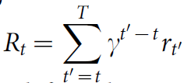
Markov Decision Process(MDP)
S : finite set of states (observations)
A : finite set of actions
P : transition probability
R : immediate reward
γ : discount factor
Goal :
Choose policy π
Maximize expected return :

Slide 14
How to Solve MDP
Dynamic Programming
Monte-Carlo
Temporal-Difference
Q-Learning

Slide 15
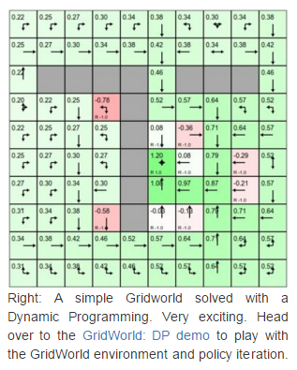
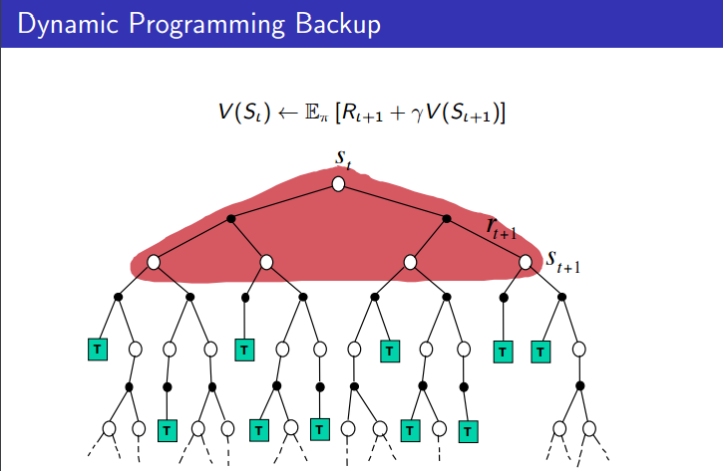
Model-based
Dynamic Programming
Evaluate policy
Update policy

Slide 16
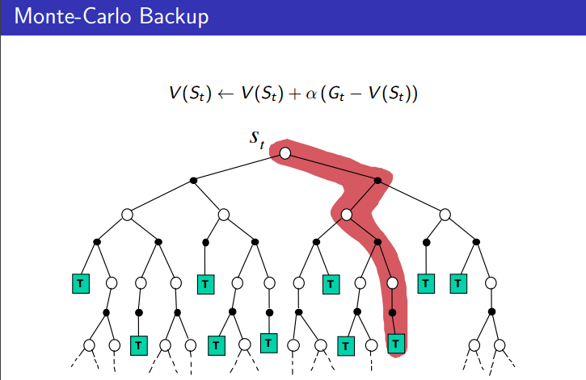
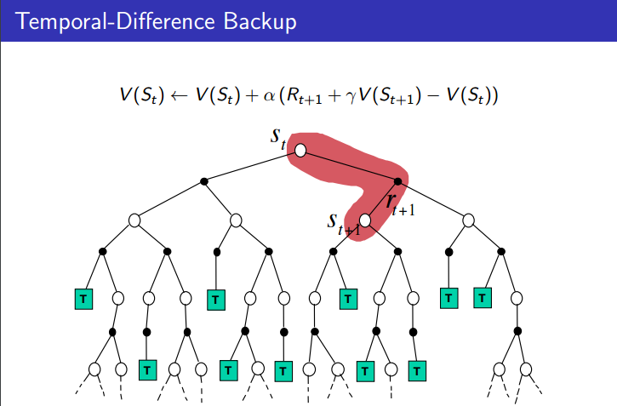
Model Free
Unknown Transition Probability & Reward
MC vs TD

Slide 17


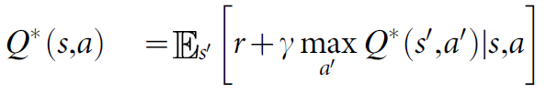

Model Free: Q-learning
Instead of tabular
optimal action-value function (Q-learning)
=
Bellman equation
Basic idea : iterative update (lack of generalization)
In practical : function approximator
Linear ?
Using DNN !

Slide 18
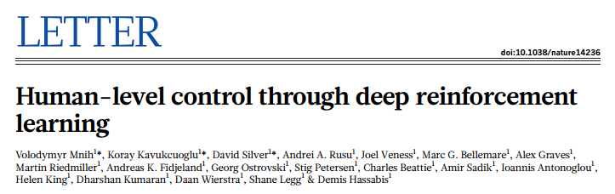
Deep Q-network (DQN)

Slide 19
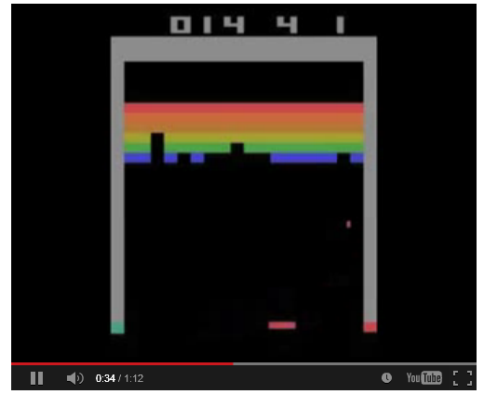
Video
https://www.youtube.com/watch?v=LJ4oCb6u7kk

Slide 20
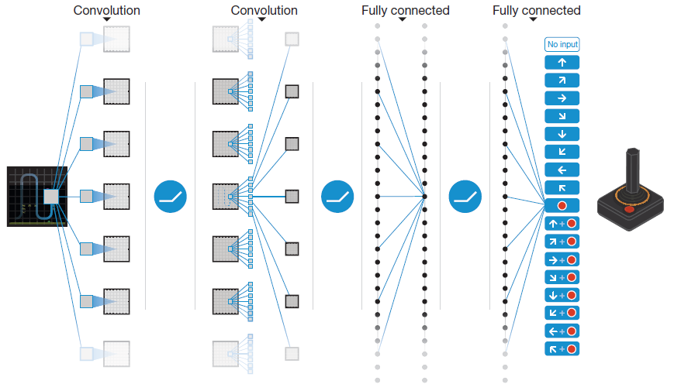
Deep Q-Network
compute Q-values for all actions
Full-connected 512 nodes
Input : 84x84x4
Output a node for each action
Convolves 32 filters of 8x8 with stride 4
Convolves 64 filters of 4x4 with stride 2
Convolves 64 filters of 3x3 with stride 1

Slide 21
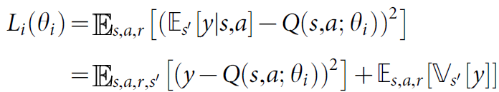

Update DQN
Loss function
Gradient

Slide 22


Two Technique
Experience Replay
Experience
Pooled Memory
Data efficiency (bootstrap)
Avoid correlation between samples (variance between batches)
Off –policy is suitable for Q-learning
Random sampled mini-batch
Prioritized sweeping (active learning)
Separate Target Network
more stable than online learning
 | Example | Learn the value of… | Pros & Cons
On-policy | SARSA | policy being carried out by the agent | Fast but weak
Off-policy | DQN | optimal policy independently of the agent's actions | Slow but robust

Slide 23
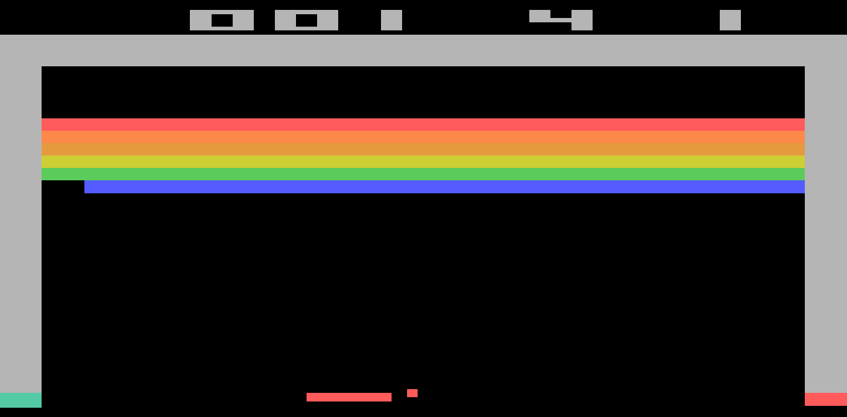
DEMO

Slide 24
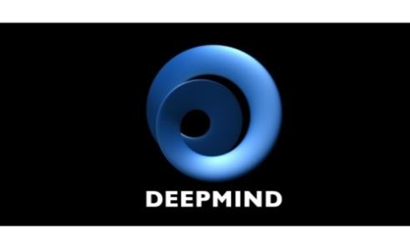
Paper review

Slide 25
Paper list
Massively Parallel Methods for Deep Reinforcement Learning
Continuous control with deep reinforcement learning
Deep Reinforcement Learning with Double Q-learning
Policy Distillation
Dueling Network Architectures for Deep Reinforcement Learning
Multiagent Cooperation and Competition with Deep Reinforcement Learning
Notes:
Deep Reinforcement Learning with Double Q-learning
http://arxiv.org/abs/1509.06461 Variational Information Maximisation for Intrinsically Motivated Reinforcement Learning
http://arxiv.org/pdf/1509.08731v1.pdf
Policy Distillation
http://arxiv.org/abs/1511.06295

Slide 26
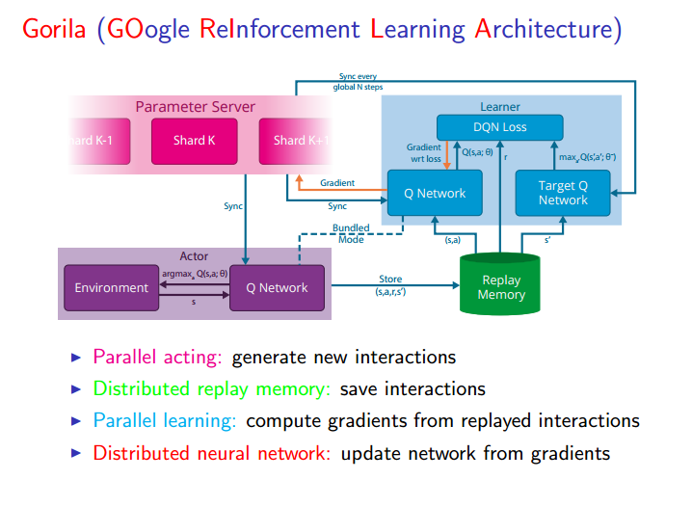
Massively Parallel Methods for Deep Reinforcement Learning
Arun Nair
arXiv:1507.04296
Notes:
Massively Parallel Methods for Deep Reinforcement Learning
Distributed : 分佈在不同機器上
Shard: 碎片

Slide 27
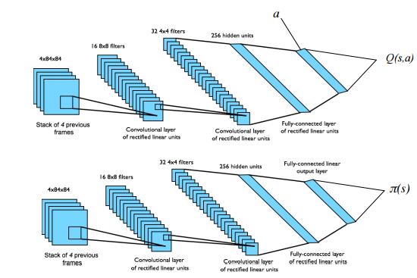
DDPG (Deterministic Policy Gradient)
DDAC (Deep Deterministic Actor-Critic)
Continuous control with deep reinforcement learning
Timothy P. Lillicrap
arXiv:1509.02971
https://goo.gl/J4PIAz
Notes:
http://arxiv.org/abs/1509.02971
Deterministic ⬅ ➔ stochastic policies 猜拳
Policy Gradient
Continuous
Deterministic Actor-Critic
DDAC

Slide 28


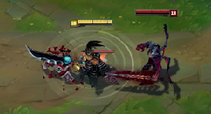
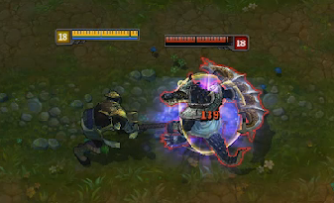
Double Q-learning

Slide 29
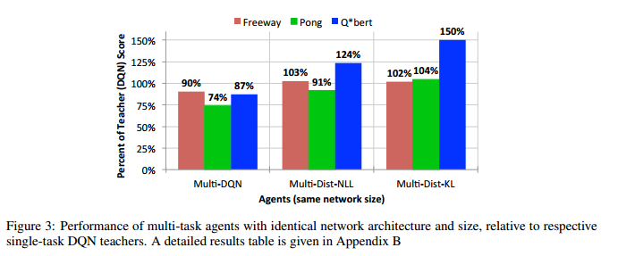
Policy Distillation
Soft target

Slide 30
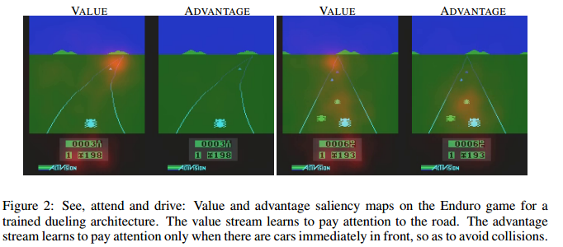
Dueling Network

Slide 31
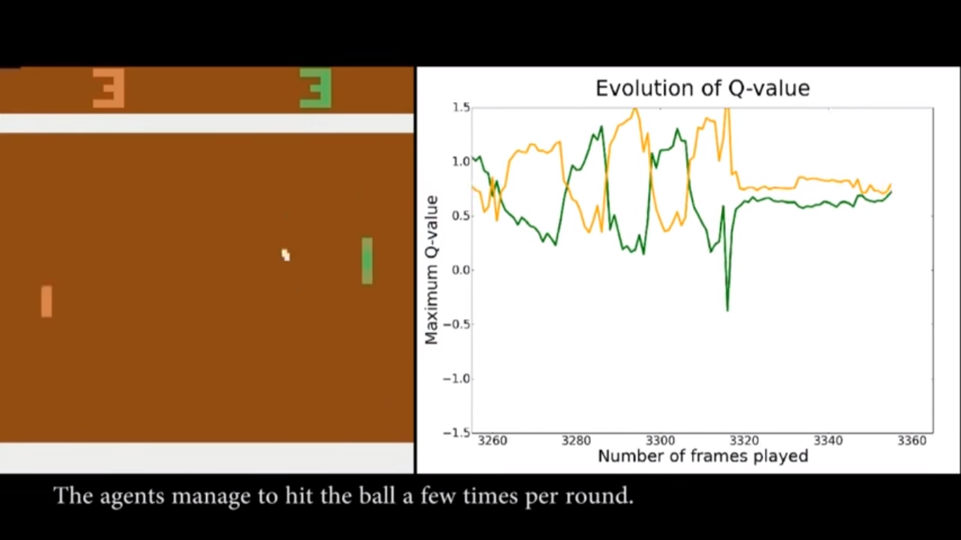
Multiagent

